Slide 1
MSaaS Chat Tool Demo / Ride Along
- Azure CSS Chat Team

Slide 2
Agenda
Walkthrough
MSaaS Tool Overview
Initiating Chat
Engineer troubleshooting
Chat Survey
Best Practices MSaaS Tool

Slide 3
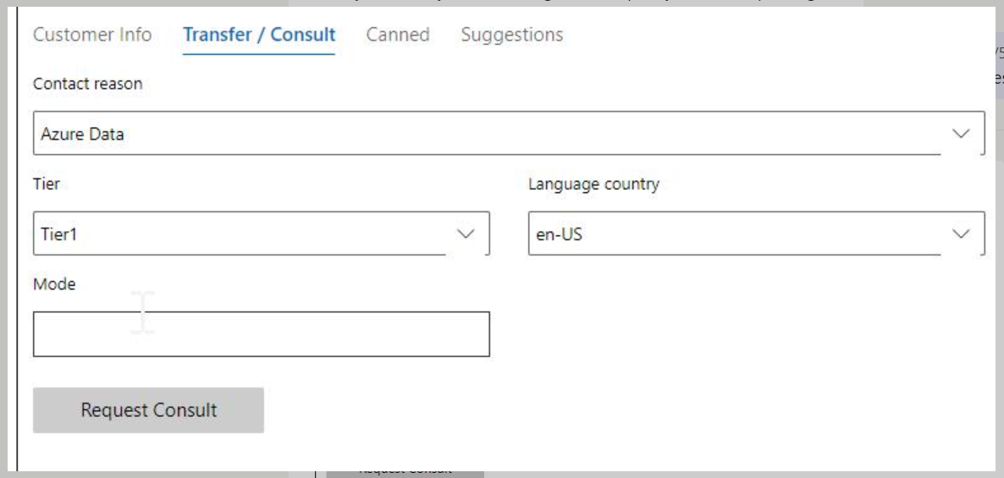
Internal Chat Transfer: To route chats to correct queues

Slide 4
Links
MSaaS Comm Console
MSaaS Insights
View Transcripts based on Visit ID

Slide 5
ACE Playbook
Best Practices MSaaS
ACE Playbook

